Slide 1
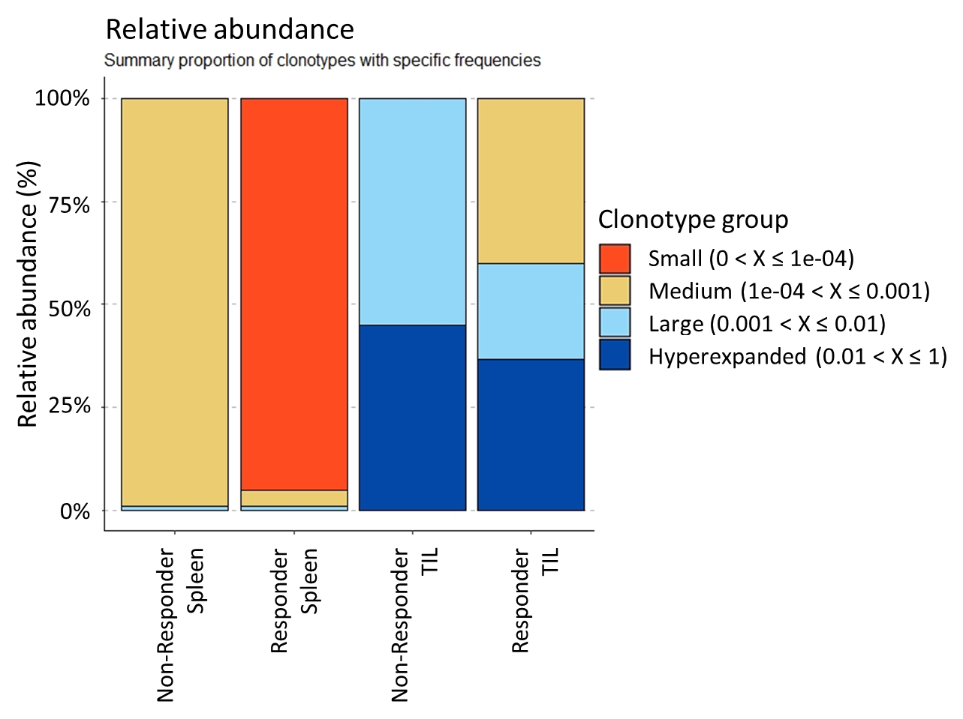
Figure 1. Relative abundance of TCR clonotypes in different samples. Relative abundance of TCR clonotypes in 4 sequenced samples including Non-Responder splenic CD8, Non-Responder CD8 TIL, Responder splenic CD8, and Responder CD8 TIL. In each sample, for each clonotype its relative abundance was calculated. These clonotypes were grouped based on their relative abundance as small (0 < x ≤ 1e-04), medium (1e-01 < x ≤ 0.001), large (0.001 < x ≤ 0.01), and hyperexpanded (0.01 < x ≤ 1).

Slide 2
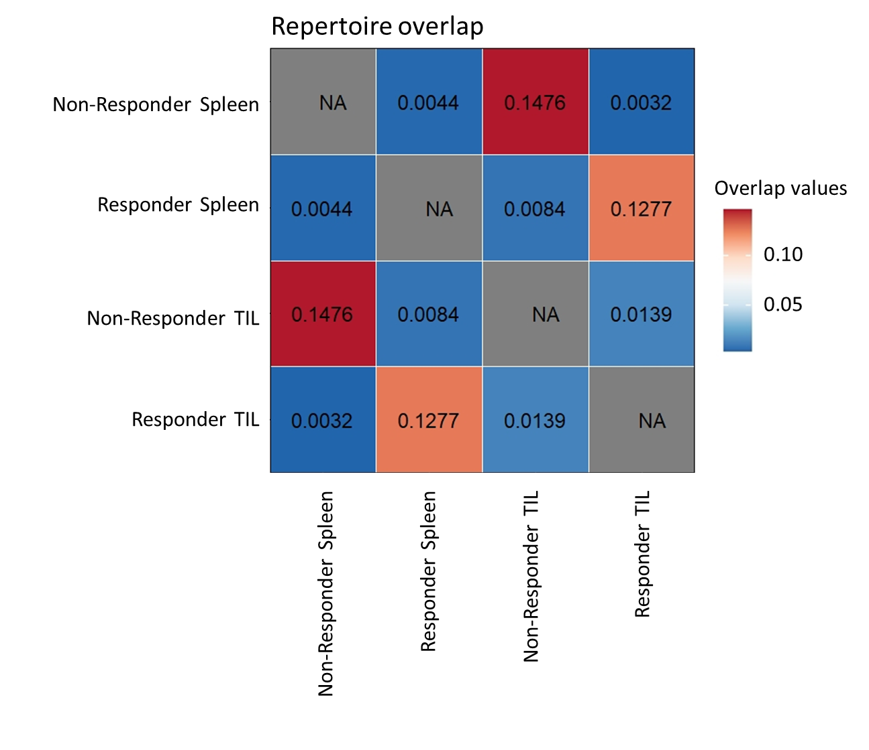
Figure 2. Repertoire overlap of TCR clonotypes between different samples. The overlap coefficient was calculated in a pairwise manner between each sample. The resulting matrix is plotted, showing the highest overlap between samples from the same individual (Non-Responder Spleen-Non-Responder TIL or Responder Spleen-Responder TIL).

Slide 3
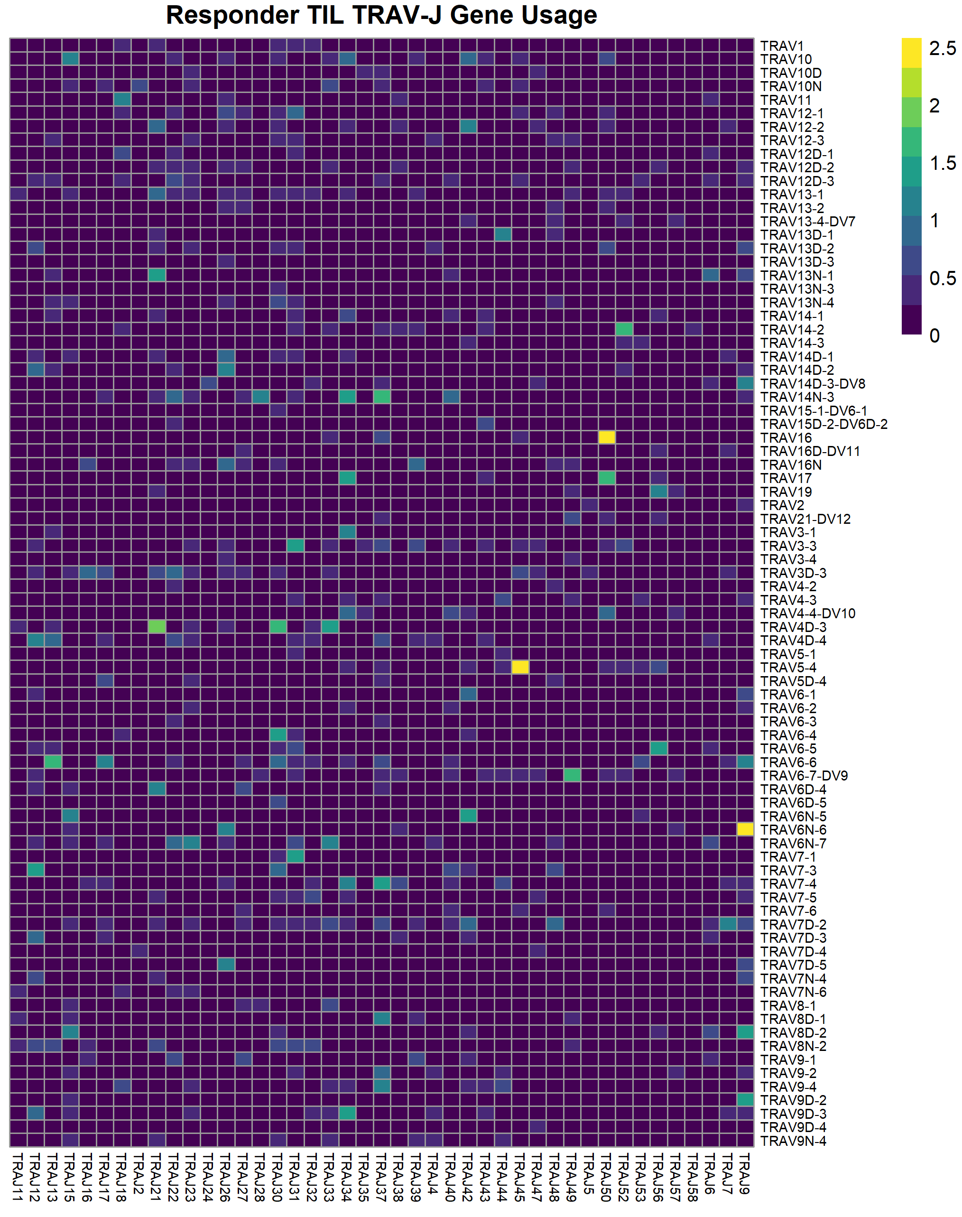
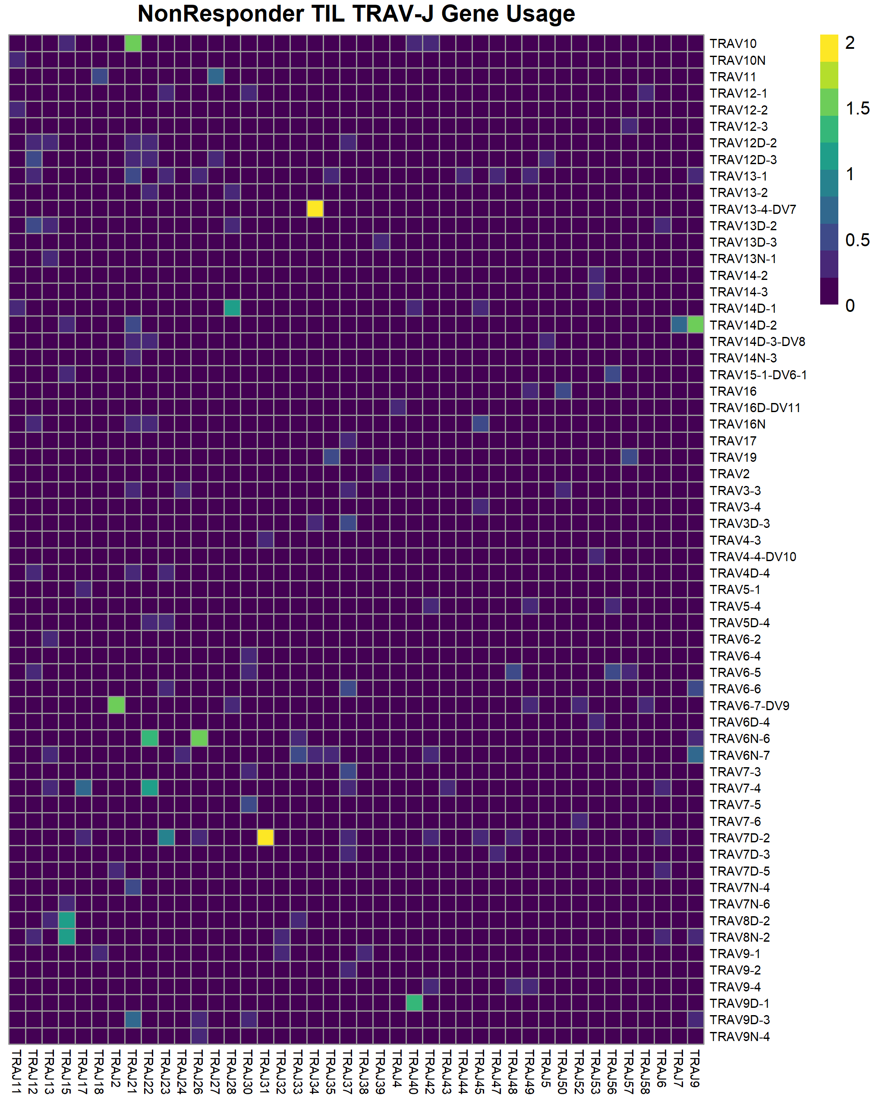
Figure 3. TCRα V-J gene usage in samples sequenced for TCR from Responder and Non-Responder TIL. TCRα V-J gene usage combinations in all T cells from each sample, colored by the log(# cells)

Slide 4
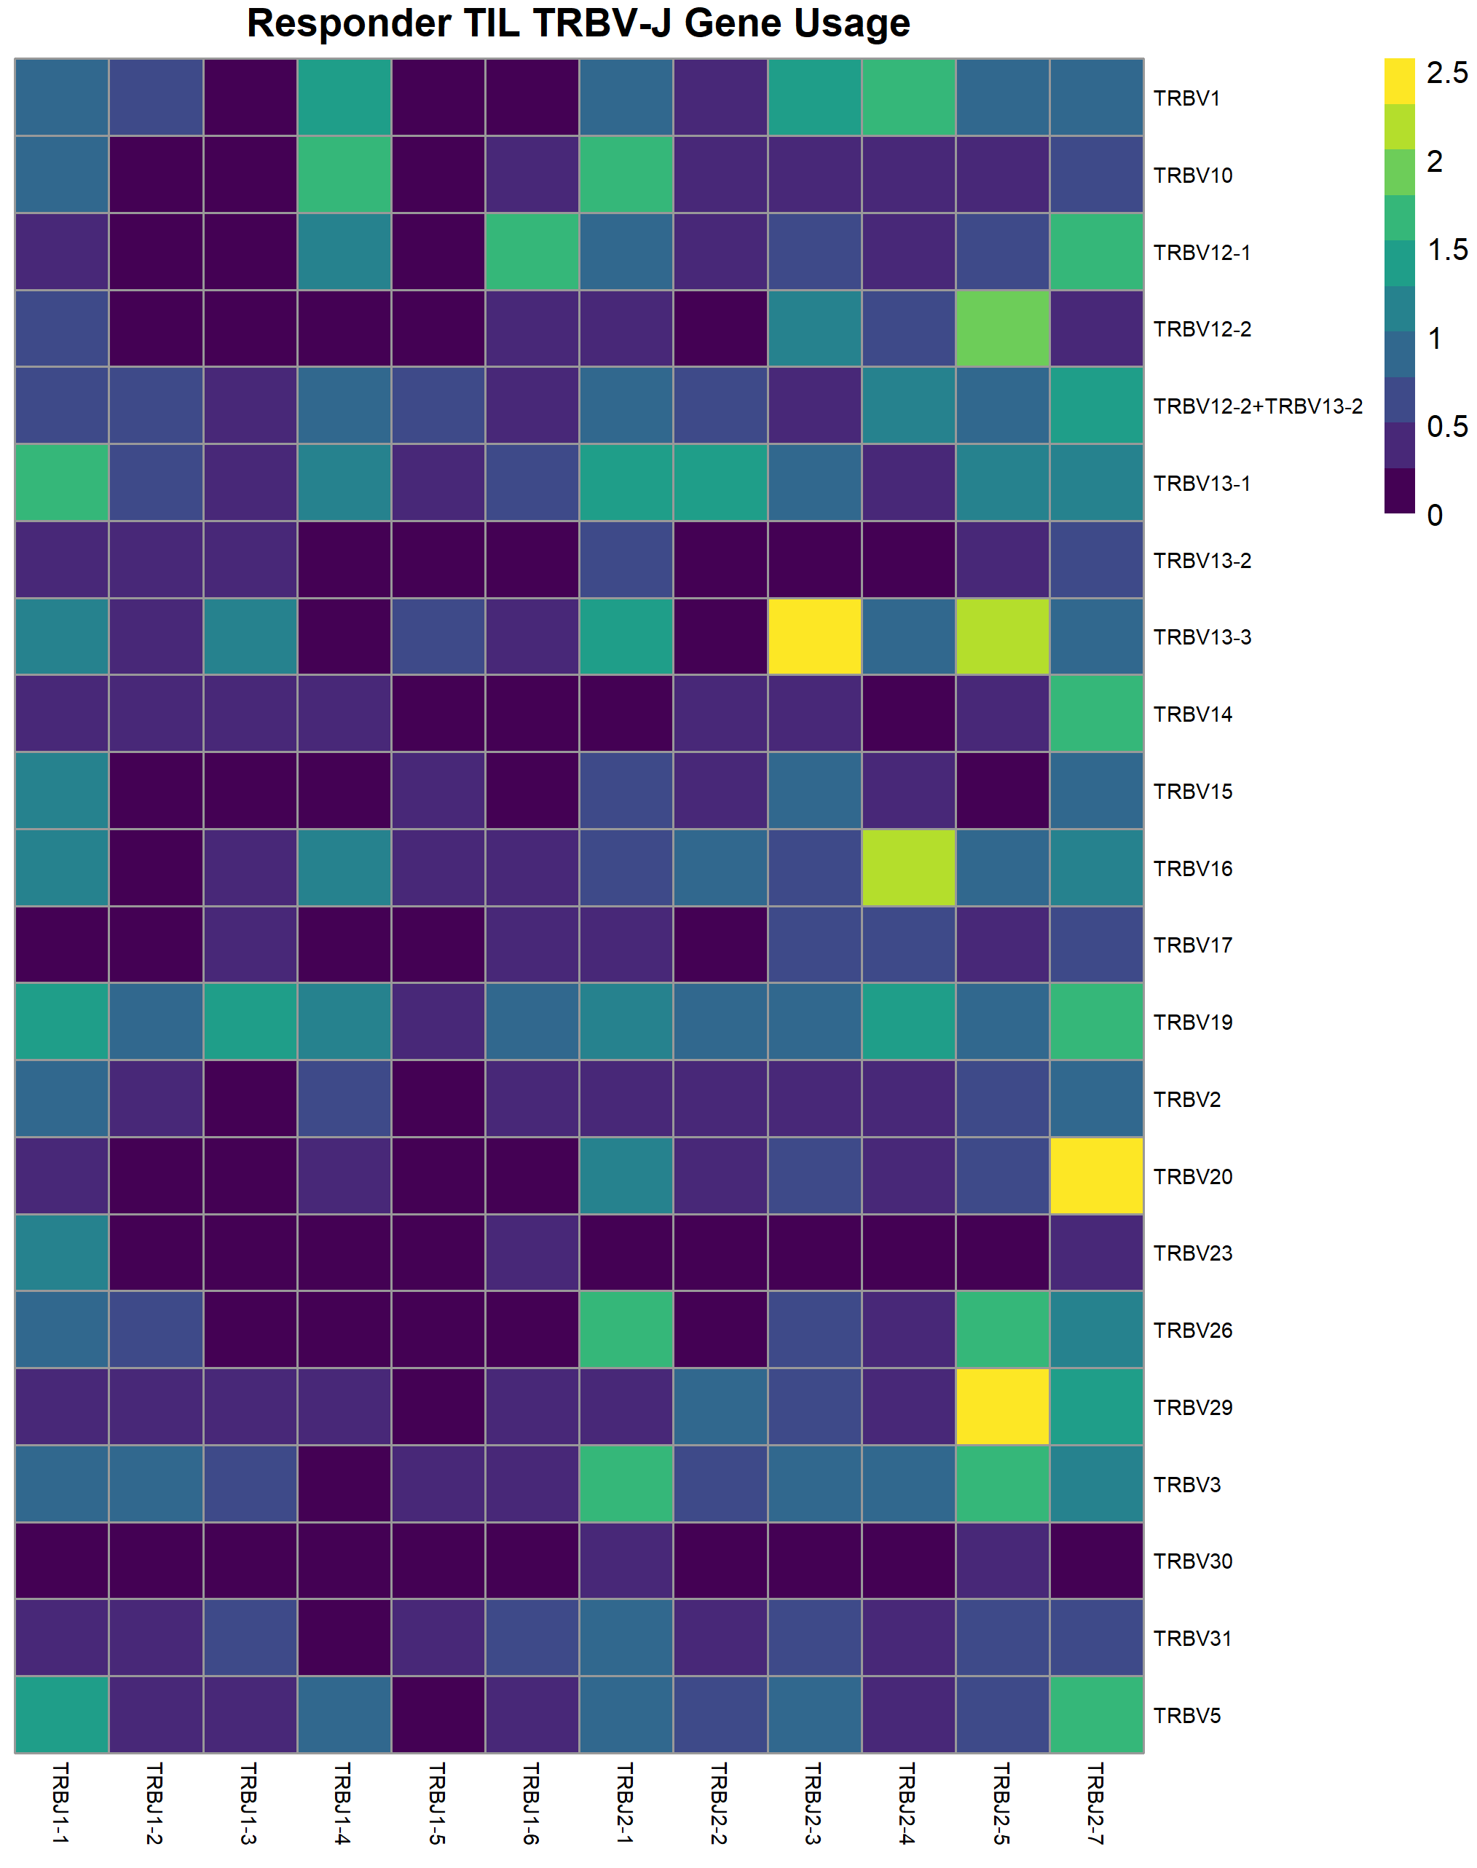
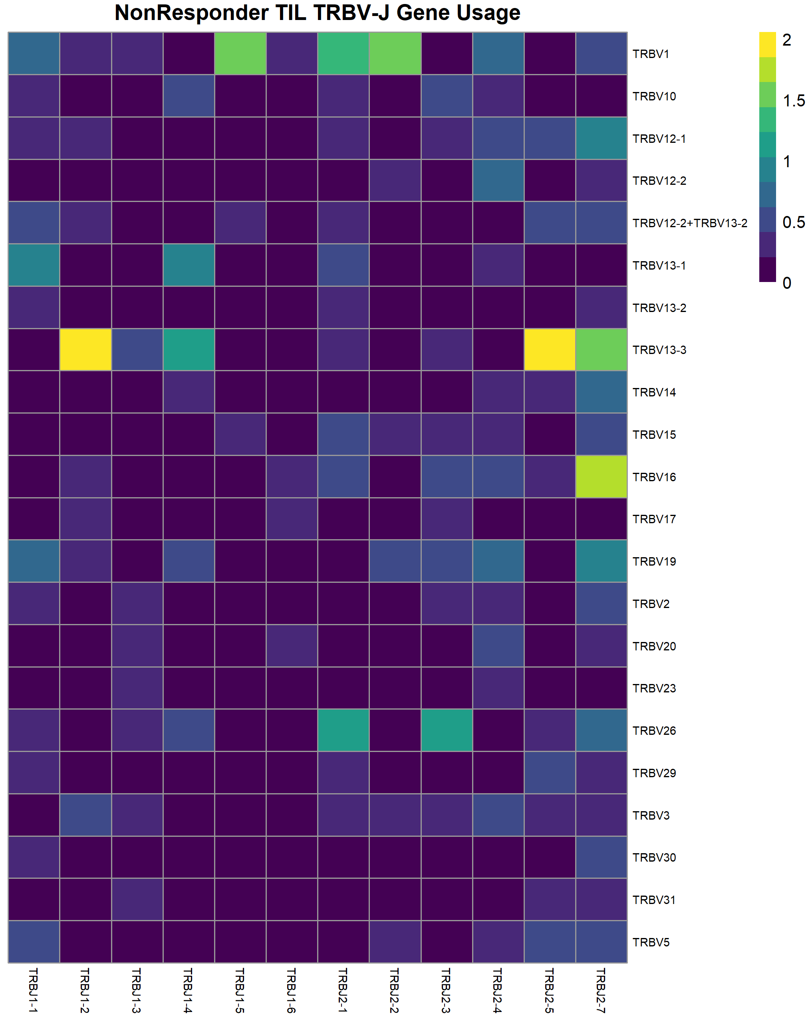
Figure 4. TCRβ V-J gene usage in samples sequenced for TCR from Responder and Non-Responder TIL. TCRβ V-J gene usage combinations in all T cells from each sample, colored by the log(# cells)

Slide 5
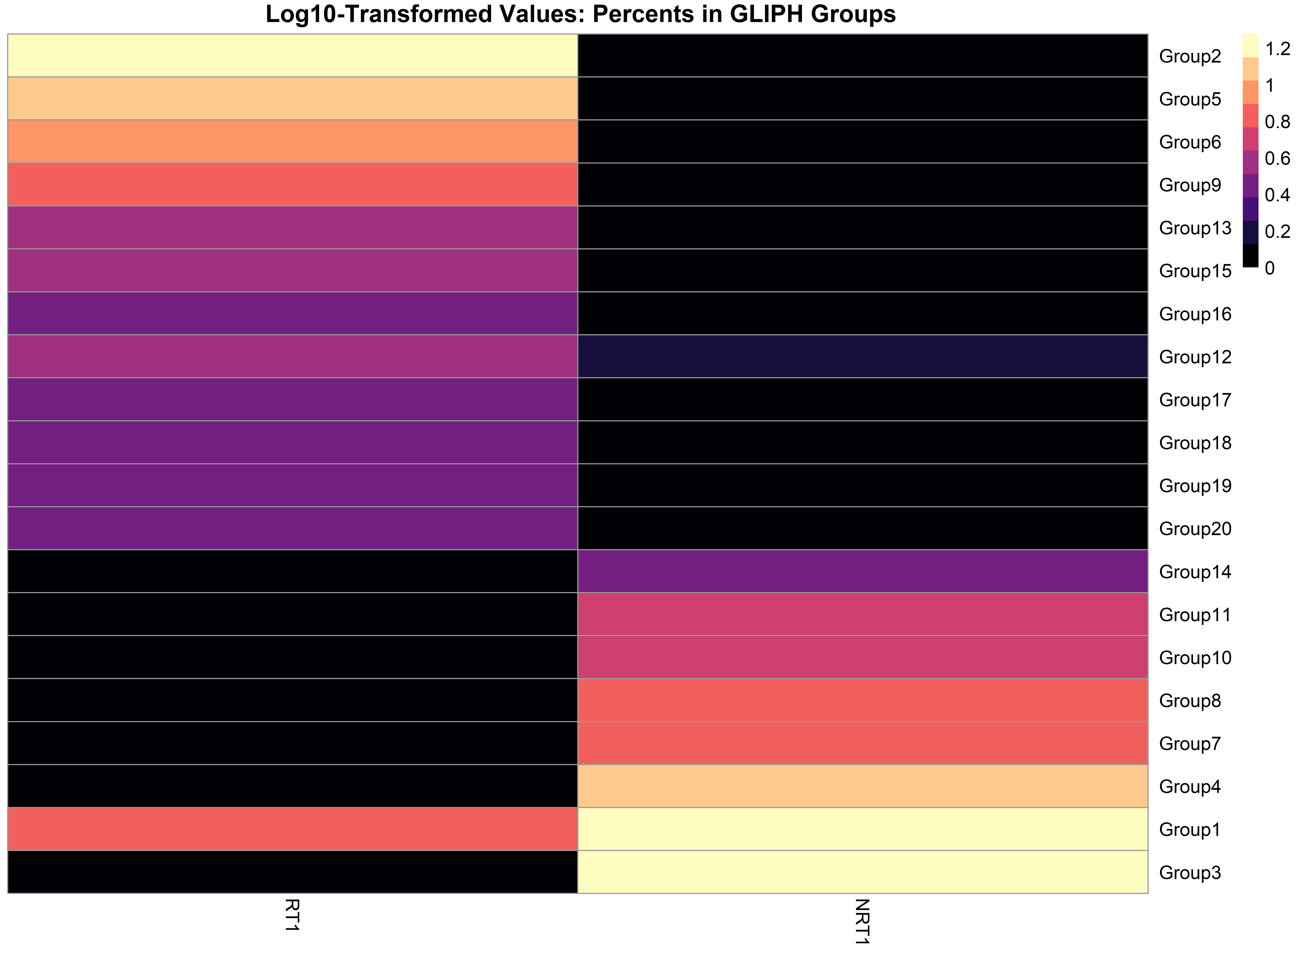
Responder
Non-Responder
Figure 5. Percent of top 20 GLIPH groups in each Responder or Non-Responder TIL sample. The GLIPH algorithm was used to determine groups of clonotypes with high probability of having similar antigen recognition. The percentages of the top 20 groups in each sample is plotted, colored by the log10(percent).

Slide 6
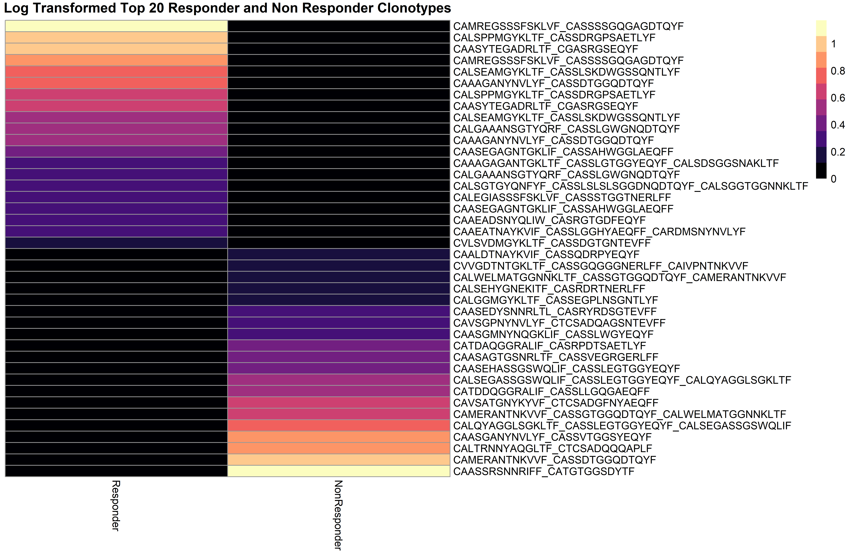
Figure 6. TCR clonotypes are mutually exclusive between responder and non-responder. Cells were grouped into clonotypes based on the paired amino acid seuqences of their CDR3α and CDR3β regions. Top clonotypes are shown in a heatmap sorted abundance in the responder vs abundance in the non-responder.

Slide 7
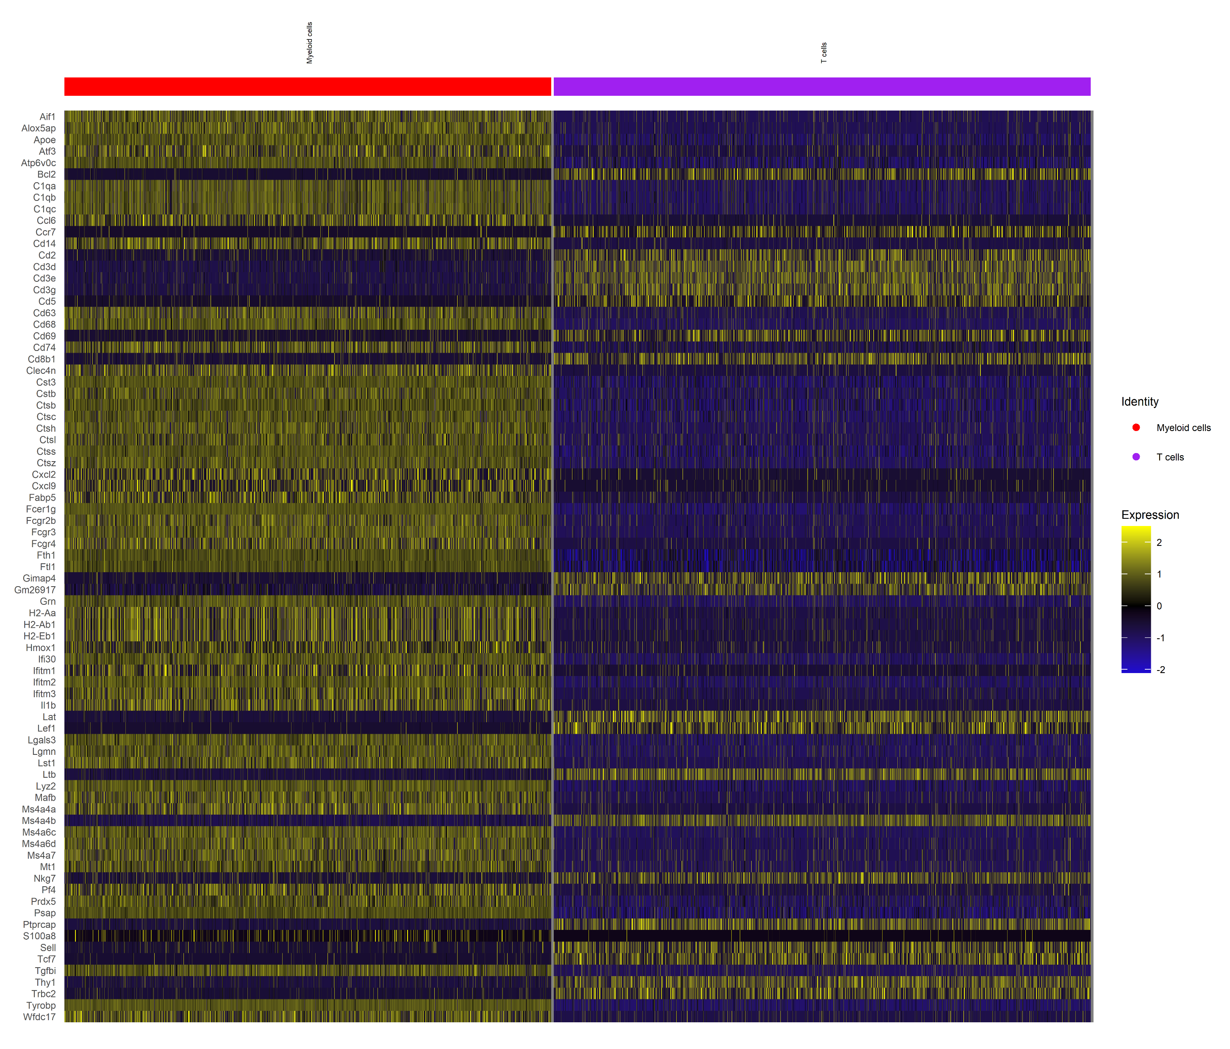
Myeloid cells
T cells
Figure 7. Myeloid and T cells have significantly different gene expression. The cells from all 4 samples were combined in Seurat. The T cells were separated from the myeloid cells by using the markers for each cluster determined with the FindMarkers function. Each population of cells was then randomly downsampled and plotted as a heatmap. The genes with the largest log fold change were plotted alphabetically.

Slide 8
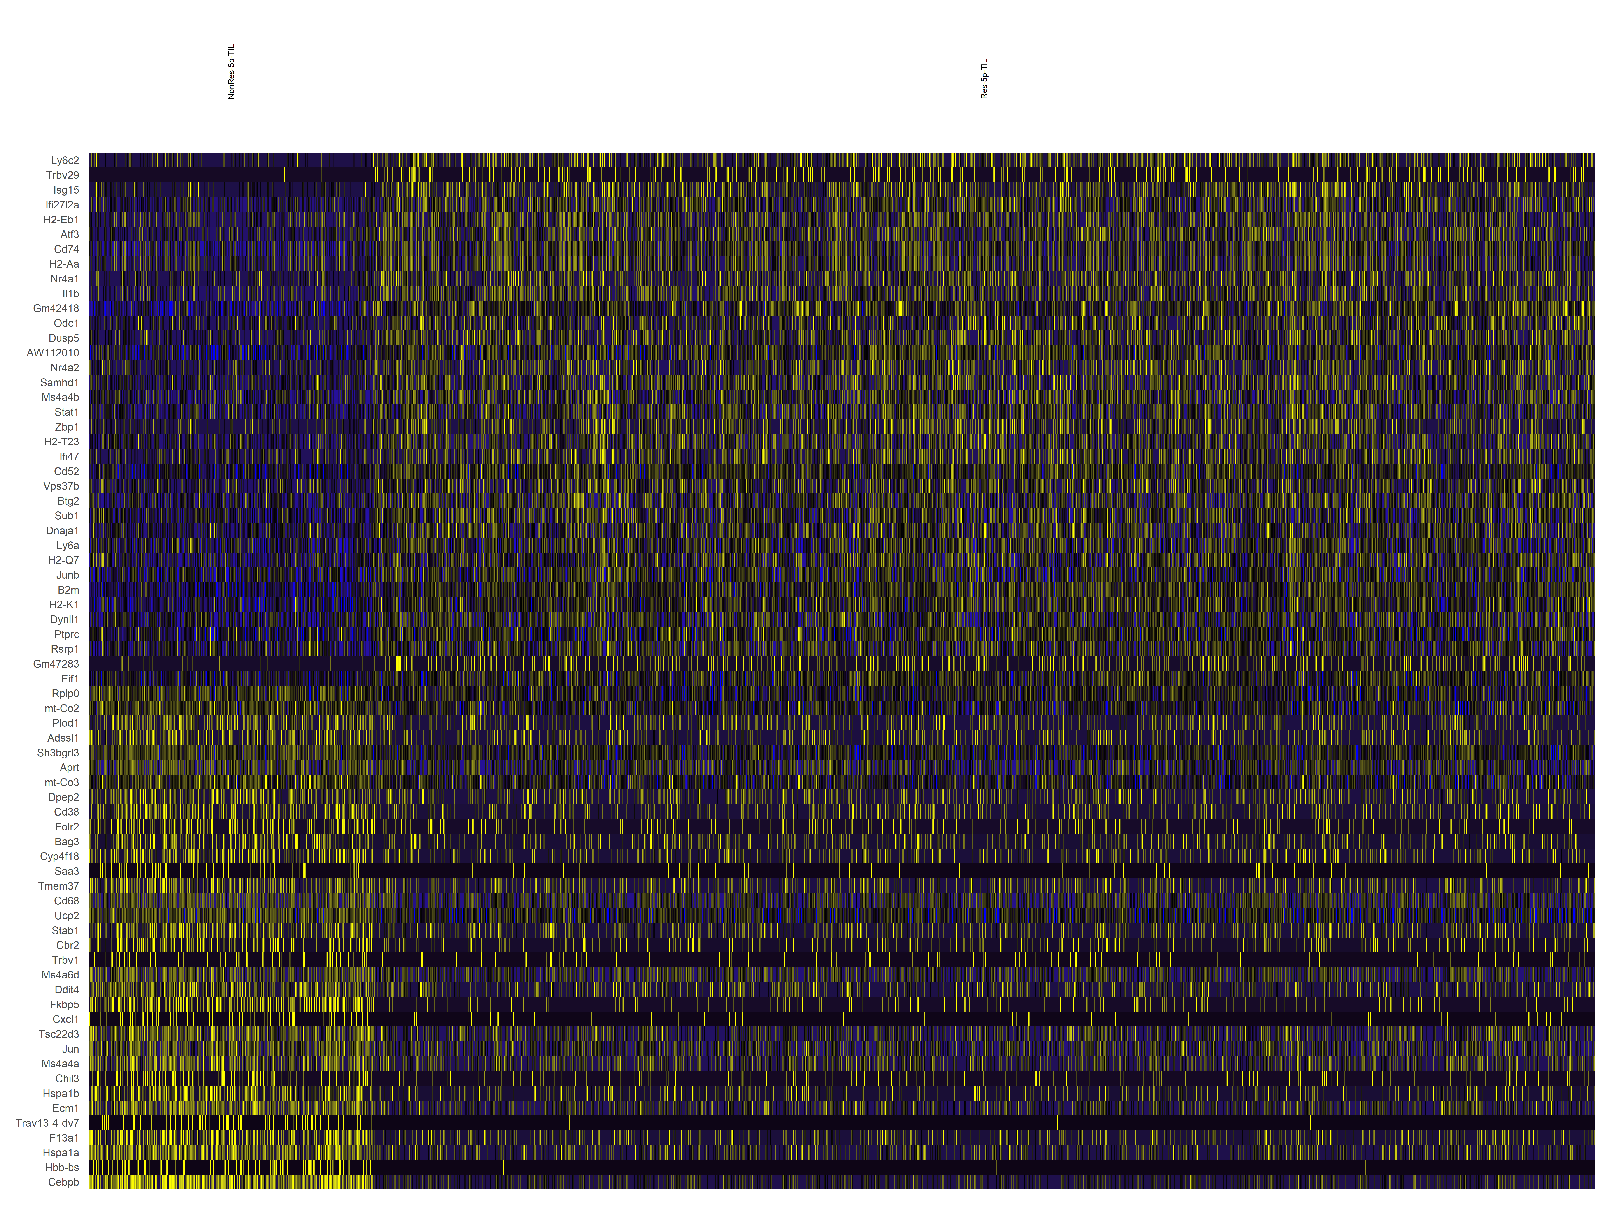
Non-Responders
Responders
Figure 8. TIL T cells from Responder and Non-Responder mouse have different gene regulation. The T cells were extracted from the samples. The Responder and Non-Responder samples were compared using the FindMarkers function in Seurat. The genes with the largest fold change of Responder vs Non-Responder scaled expression were plotted as a heatmap.

Slide 9
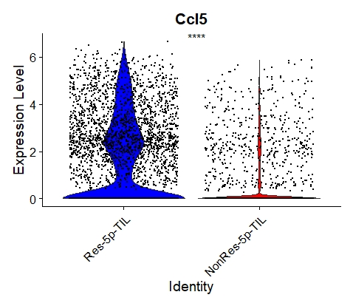
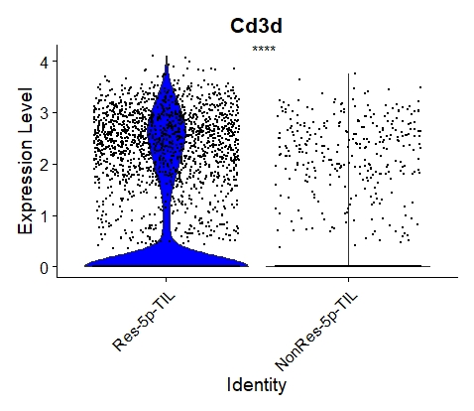
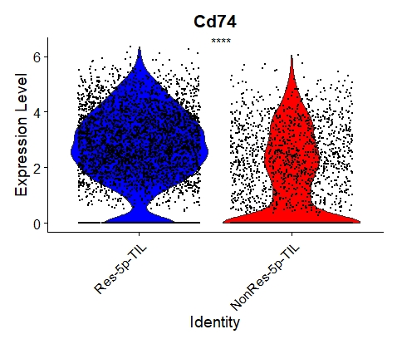
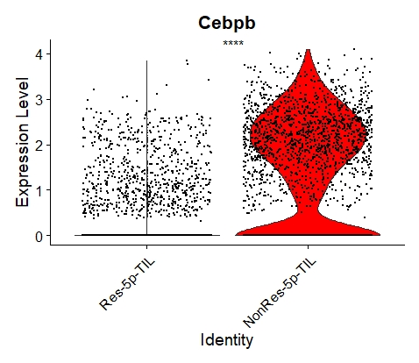
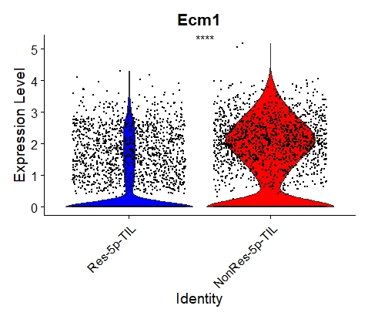
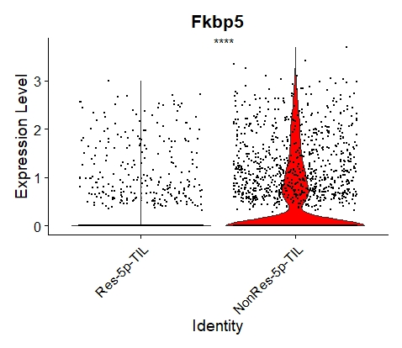
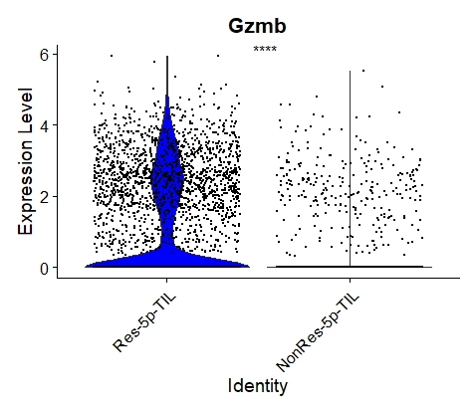
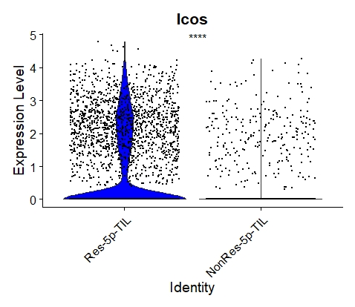
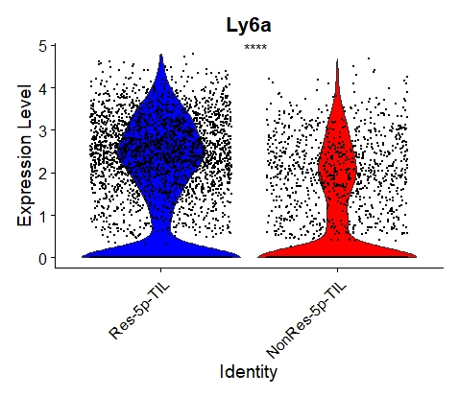
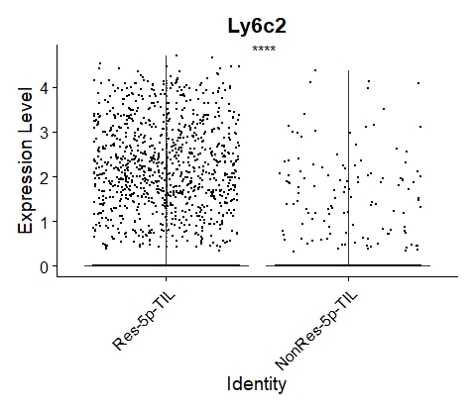
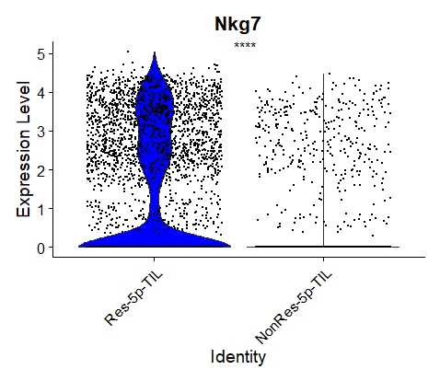
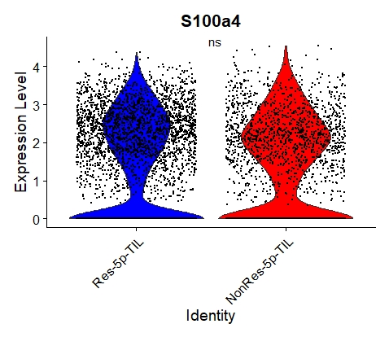
Figure 9. Violin plots of select differentially expressed genes between Responder and Non-Responder TIL T cells. The normalized gene expression for each cell is shown as black dots. The groups were compared using Wilcoxon Test and the resulting p-value is shown. (**** p<=0.0001, ns p>0.01)

Slide 10
Responders
Non-Responders
Figure 10. Top TCR clonotypes of Responder TIL versus Non-Responder TIL show differently activated genes. The expression for all cells with an identified clonotype was scaled. This was then used to compare the Responder sample from the Non-Responder sample using the FindMarkers function in Seurat. The clonotypes with the highest number of cells identified in the scRNA-seq data were determined. The gene expression is shown by heatmap where the values are the scaled gene expression, and the genes with the highest fold change are plotted.

Slide 11
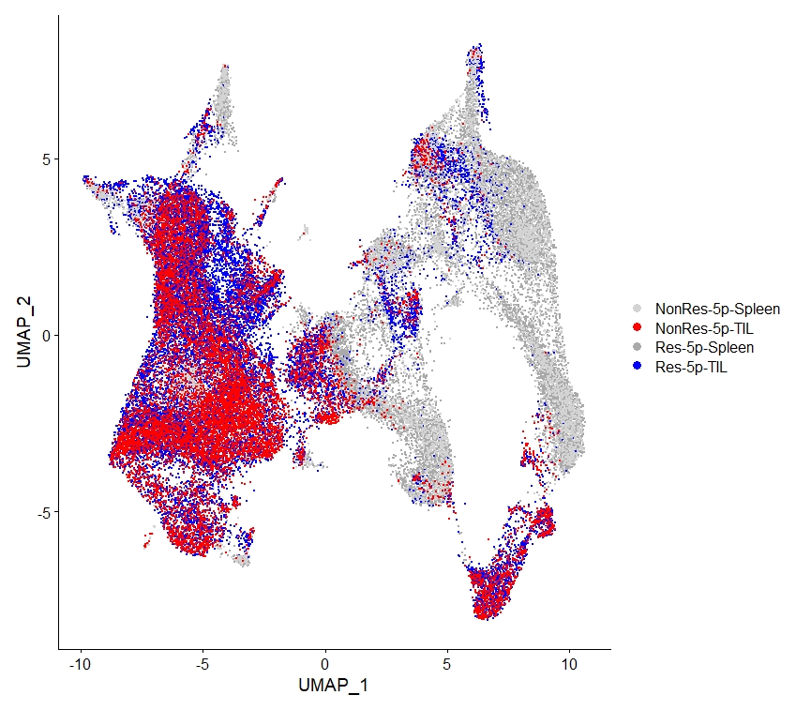
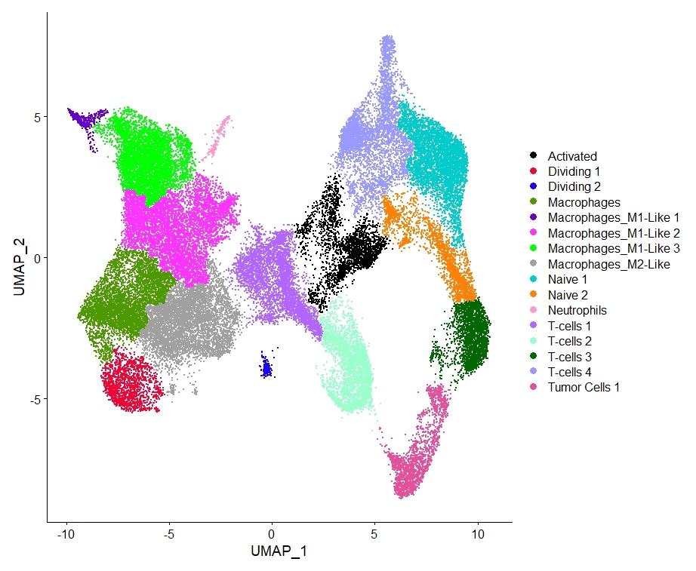
Figure 11. UMAP plots of combined scRNA-seq data colored by sample and cluster. The samples were integrated in Seurat and the FindNeighbors function was used with UMAP reduction. The FindClusters function was then used and resulting clusters plotted with 0.1 resultion. The TIL samples clustered together, and the spleen samples clustered together. The FindMarkers function was used to find gene markers of each cluster and used to identify cell types. There were many myeloid cells, a cluster of tumor cells, as well as many T cell clusters.

Slide 12
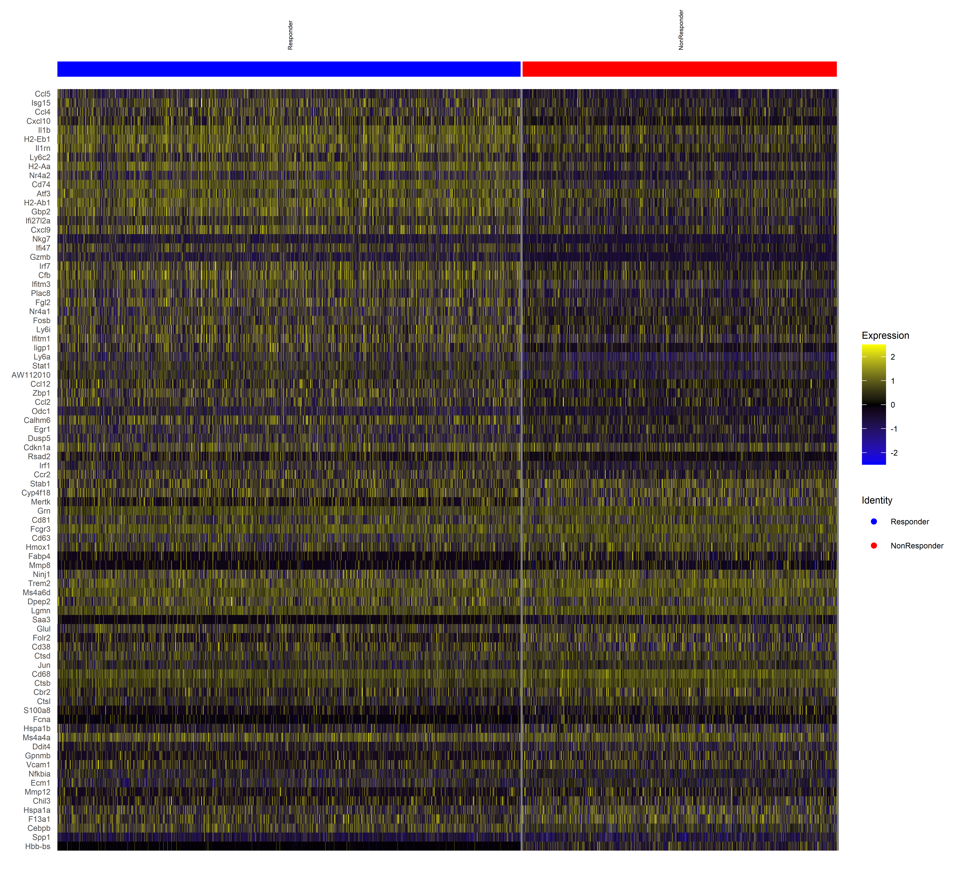
Figure 12. Myeloid cells from Responder and Non-Responder mouse do not have distinct gene regulation patterns. The myeloid cells were extracted from the samples. The Responder and Non-Responder samples were compared using the FindMarkers function in Seurat. The genes with the largest fold change of Responder vs Non-Responder scaled expression were plotted as a heatmap. There are significantly differently regulated genes but not in distinct patterns between the responders and non-responders. There are some upregulated genes related to antigen presentation.

